Slide 1

MATRIX
WELCOME TO OUR PRESENTETION
Course Title : Mathematics-ii
Course code : Mat-121
Course teacher : Mst. Masuma pervin(map)

Slide 2
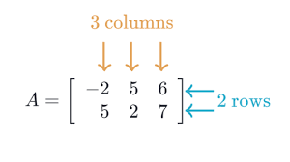
INTRODUCTION TO MATRIX
A matrix is a rectangular arrangement of numbers, expressions or symbols in rows and columns enclosed by ( ), [ ] .

Slide 3
CATECTERRISTICS OF MATRIX
Rows run horizontally and columns run vertically.
The dimensions, or size, of a matrix are number of rows X number of columns.
A matrix is usually denoted by a capital letter and the elements within the matrix are denoted by lower case letters

Slide 4
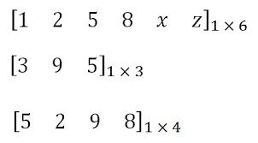
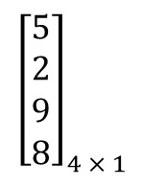
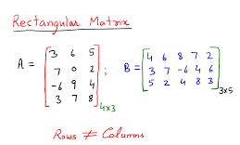
TYPES OF MATRIX
1. Row Matrix: A matrix which has only one row is called a row matrix.
2. Column Matrix: A matrix which has only one column is called a column matrix.
3. Rectangular Matrix: A matrix where number of rows is not equal to the number of columns is called rectangular matrix.

Slide 5
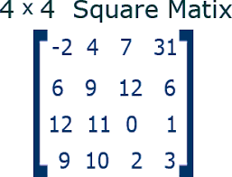
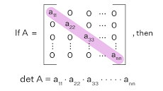
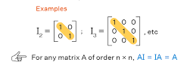
TYPES OF MATRIX
4. Square Matrix: A matrix which has the same number of rows and columns is called square matrix.
5. Diagonal Matrix: A square matrix where all the elements are zero except those on the main diagonal.
6. Identity/Unit Matrix: An identity matrix is a square matrix that has 1’s along the main diagonal and 0’s everywhere else.

Slide 6
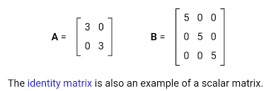
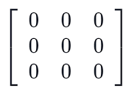
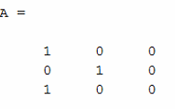
TYPES OF MATRIX
7. Scalar Matrix: A diagonal matrix whose main diagonal elements are equal.
8. Zero matrix: A matrix whose all the entries are 0.
9. Nonzero matrix: A matrix whose at least one entries is non-zero.

Slide 7
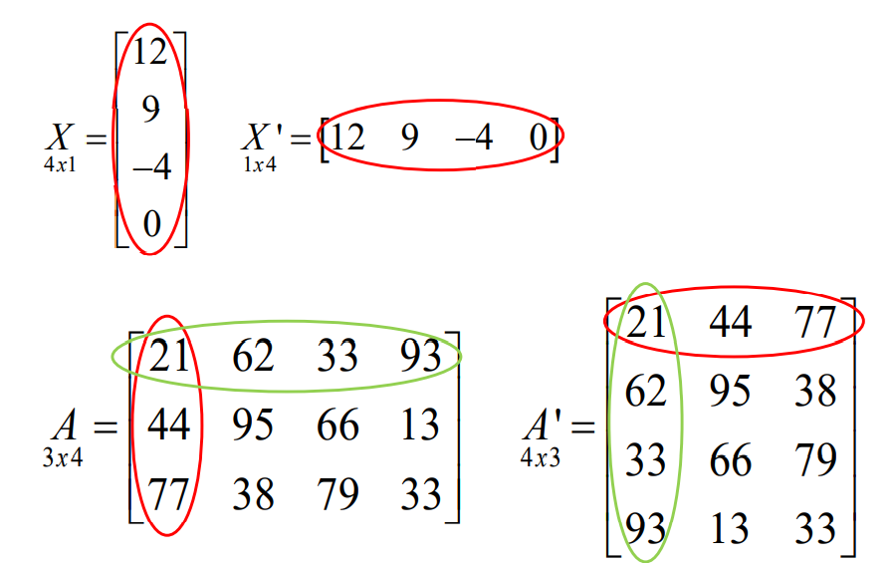
TRANSPOSE OF A MATRIX
Matrix Transpose: Transpose of a matrix A is a matrix obtained by interchanging the rows and columns of A .

Slide 8
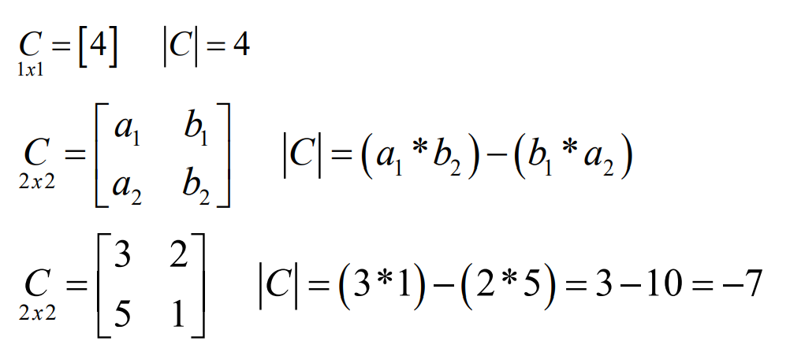
DETERMINANT OF A MATRIX
A Determinant is a number associated with a matrix. Only SQUARE matrices have a determinant. The symbol for a determinant can be the phrase “det” in front of a matrix variable,
det(A); or vertical bars around a matrix, |A| .

Slide 9
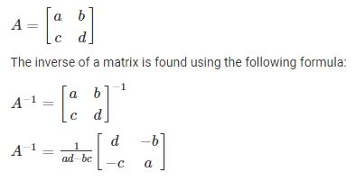
INVERSE OF A MATIX
A inverse matrix A^-1 which can be found only for a square and a non-singular matrix A, is a unique matrix satisfying the relationship.

Slide 10
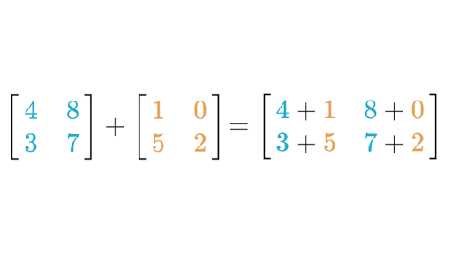
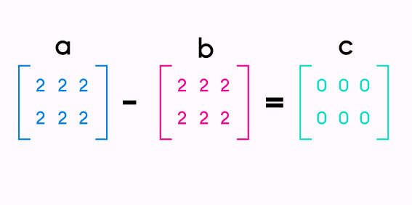
OPERATIONS OF MATRIX (Addition, Subtraction)
Two matrices can only be added or subtracted if they have the same dimensions.
Simply add (or subtract) the corresponding elements. So, A + B = C yields ú

Slide 11
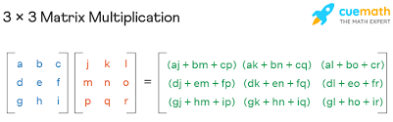
OPERATIONS OF MATRIX (Multiplication)
Matrix multiplication indicates a row-by-column multiplication, where the entries in the ith row of A are multiplied by the corresponding entries in the jth column of B and then adding the results. Matrix multiplication is NOT commutative..

Slide 12
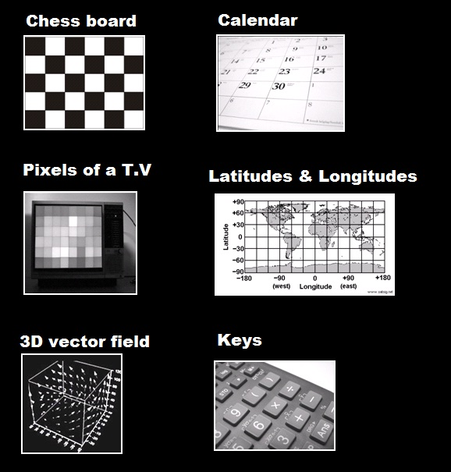
REAL LIFE APPLICATION’S
Matrix or Matrices are used in optic science to account for refraction and reflection. Matrices are also useful in electrical circuits and quantum physics. Moreover, matrices are used to solve AC network equations in electrical circuits.

Slide 13
REAL LIFE APPLICATION’S
Games especially 3D – One application of matrices is in games. We use it to alter the object, in 3d space. They use the 3d matrix to 2d matrix to convert it into the different objects as per requirement.
Animation – It can help make animations more precise and accurate.
Physics – Matrices are applied in the study of quantum mechanics, electrical circuits, and optics. It helps in the calculation of battery power outputs, resistor conversion of electrical energy into another useful energy. Therefore, matrices play a major role in calculations.

Slide 14
REAL LIFE APPLICATION’S
Use of Matrices in Computer Graphics– Earlier, architecture, cartoons, and automation were done by hand drawings but nowadays they are done by using computer graphics. Square matrices very easily represent the linear transformation of objects. They are used to project three-dimensional images into two-dimensional planes in the field of graphics. In graphics, a digital image is treated as a matrix to start with. The rows and columns of the matrix correspond to rows and columns of pixels and the numerical entries correspond to the pixels’ colour values.

Slide 15
CONCLUSION
In Mathematics, a matrix is a rectangular array or table of numbers, symbols, or expressions, arranged in rows and columns.
In our presentation we have talked about the
1.Types of Matrix,
2.Transpose of a Matrix,
3.Determinant of a Matrix,
4.Inverse of Matrix,
5.Real life Application of Matrix.

Slide 16


